Slide 1
Grant Management System
5310/5311 Application Workshop
January 10, 2019
Jackson Medical Mall – Community Room

Slide 2
Objectives
Introduce a new electronic grant-making software
Present the sub-recipient and administrator software components
Give benefits of the new system and future growth

Slide 3
Purpose
The system was designed to assist applicants to timely and effectively apply for federal grant funds for transportations services within the state. This electronic application package contains the necessary forms and instructions for a complete application.

Slide 4
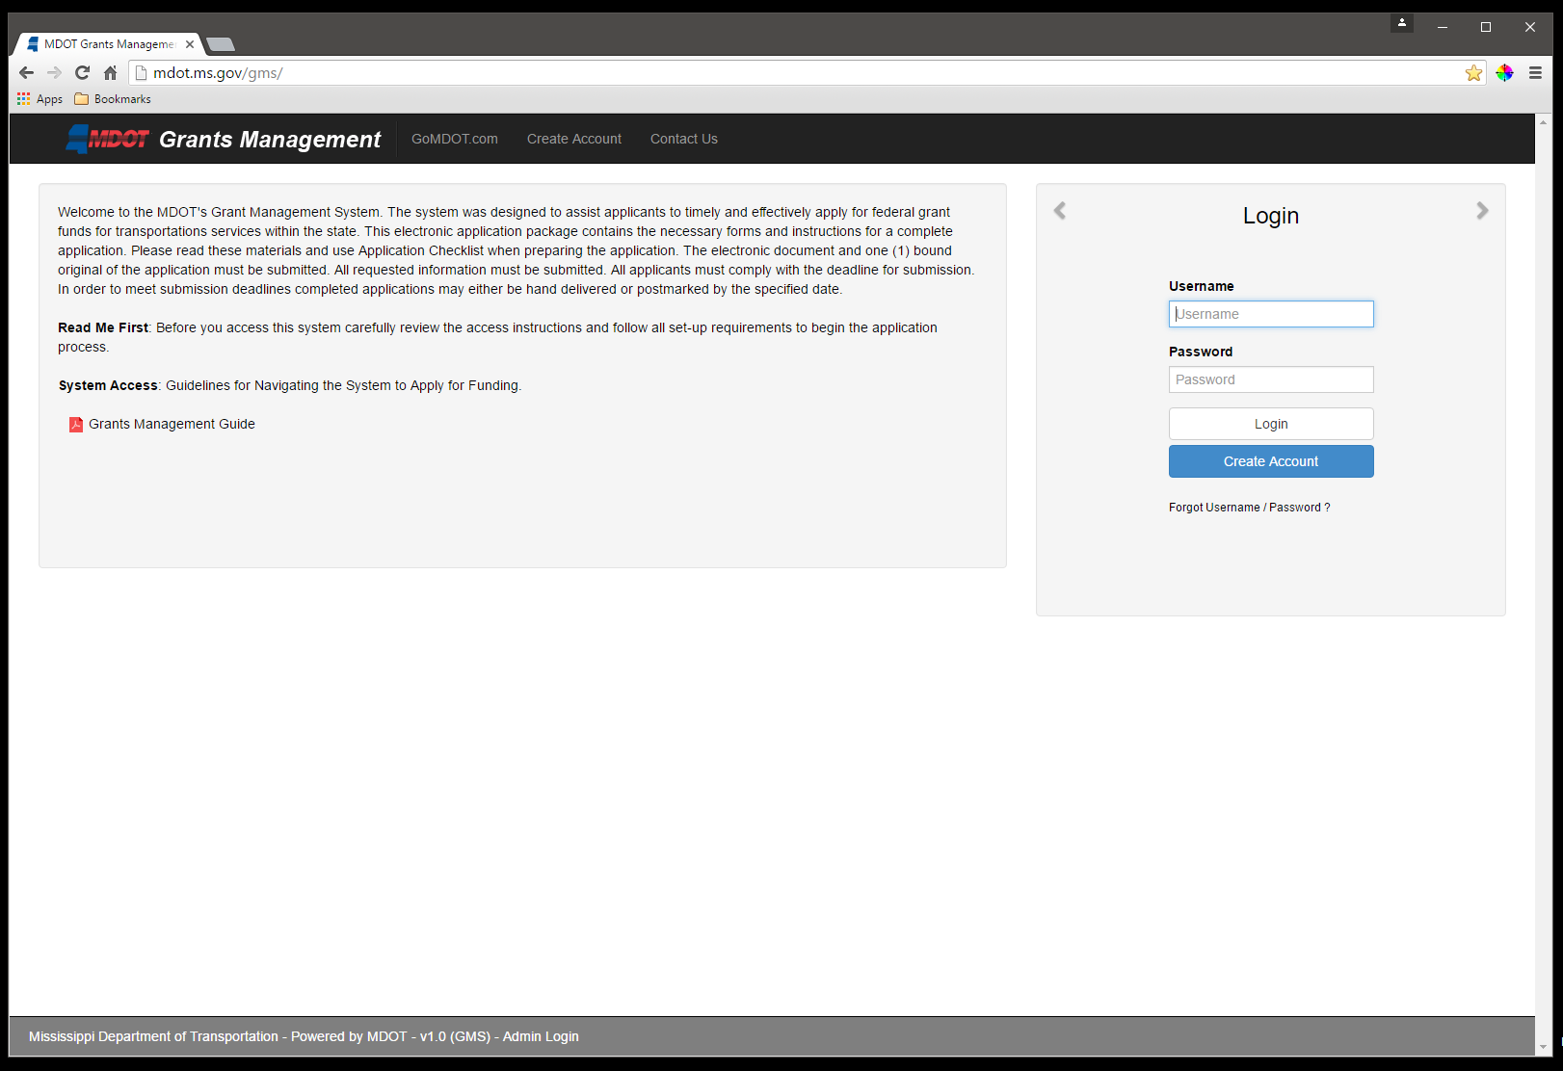
Step One
Go to the Grants Management Website:
mdot.ms.gov/gms

Slide 5
Step Two
Click “Create Account”
The link at the top of the page or the blue button

Slide 6
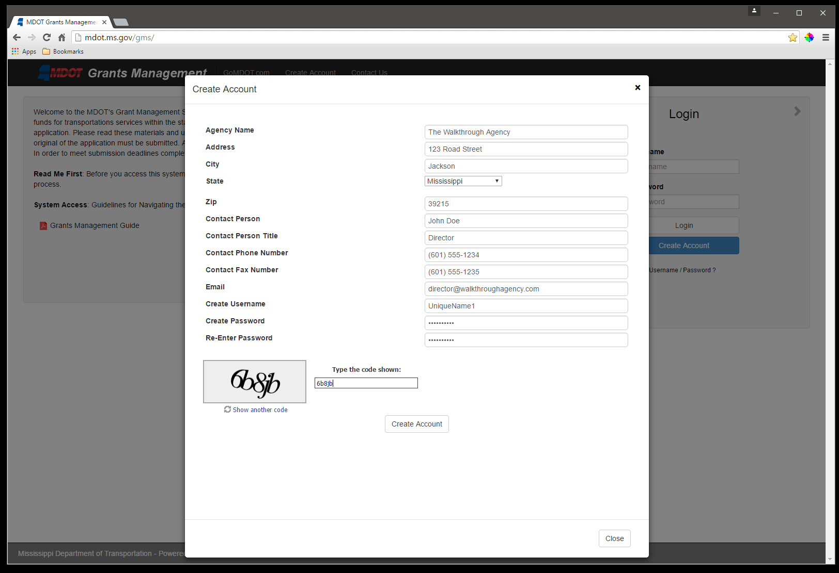
Step Three
Enter your information into the form and click the “Create Account” button

Slide 7
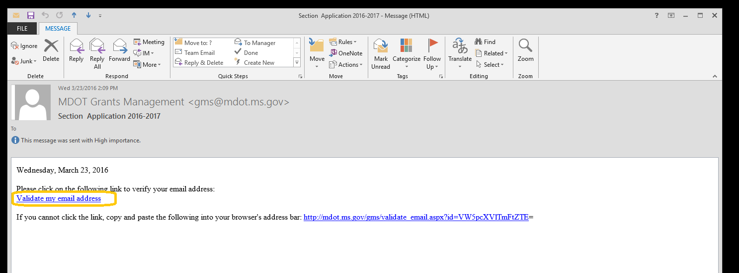
Step Four
Check your email for a verification link
Click the link.

Slide 8
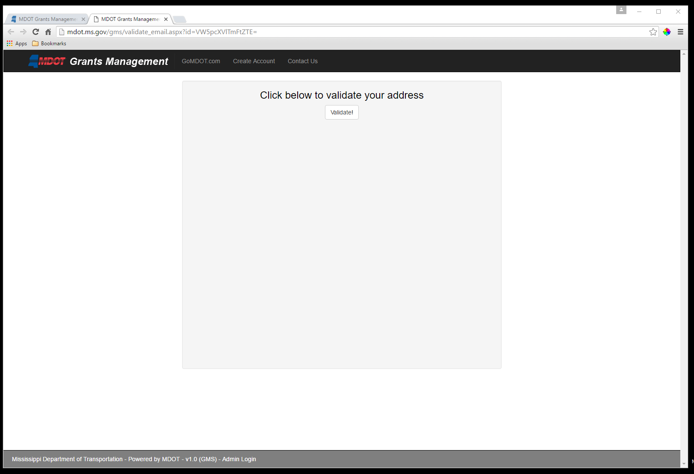
This will direct you to the validation page:
Click the “Validate!” button to finalize email validation.

Slide 9
Step Five
Wait
An email will be automatically sent from an administrator that an account has been activated. Depending on volume, this could be nearly instant, or take some time.

Slide 10
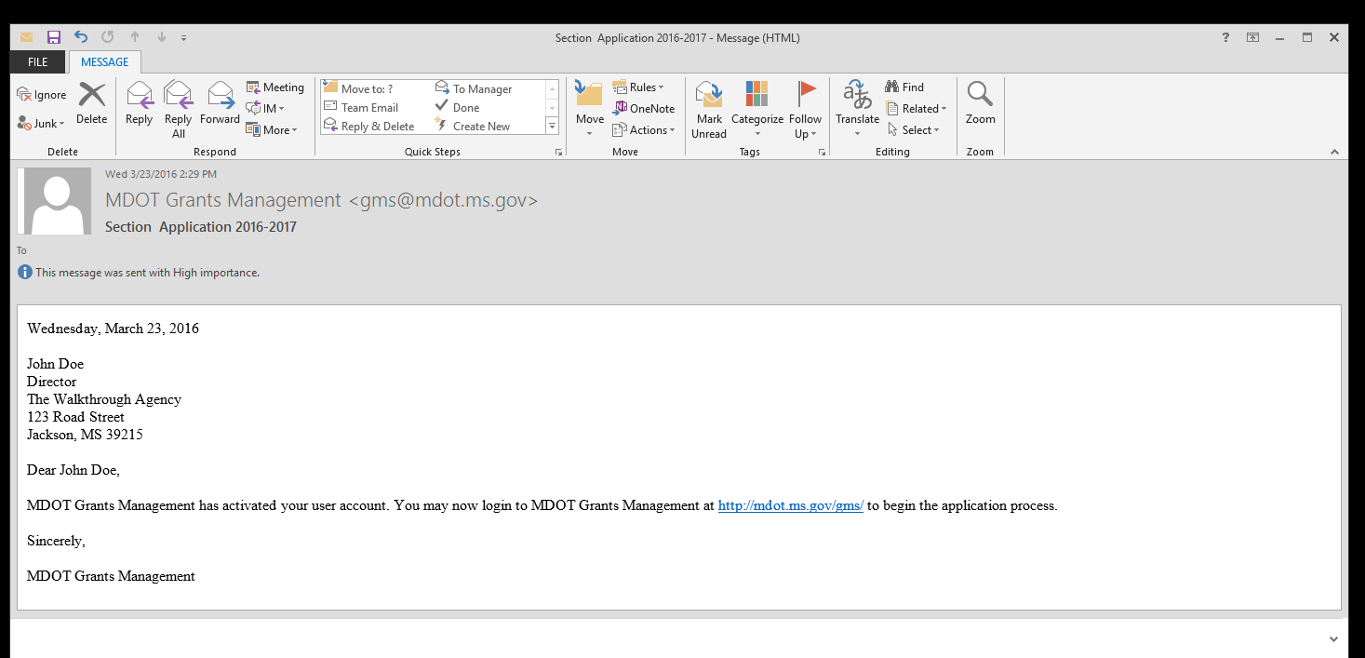
An email letting potential applicant know that their account is active will be sent.
It contains a link to return directly to the Grants Management login page
(though it is not necessary to click it or return at this exact moment)

Slide 11
Step Six
Return to Grant Management Website and enter the Username and Password that was made during account creation then click the “Login” button to enter the Grants Management system.

Slide 12
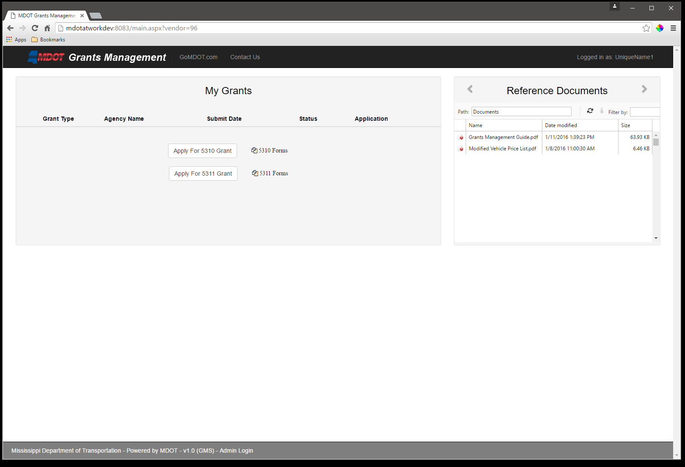
Welcome to the
Grants Management system!

Slide 13
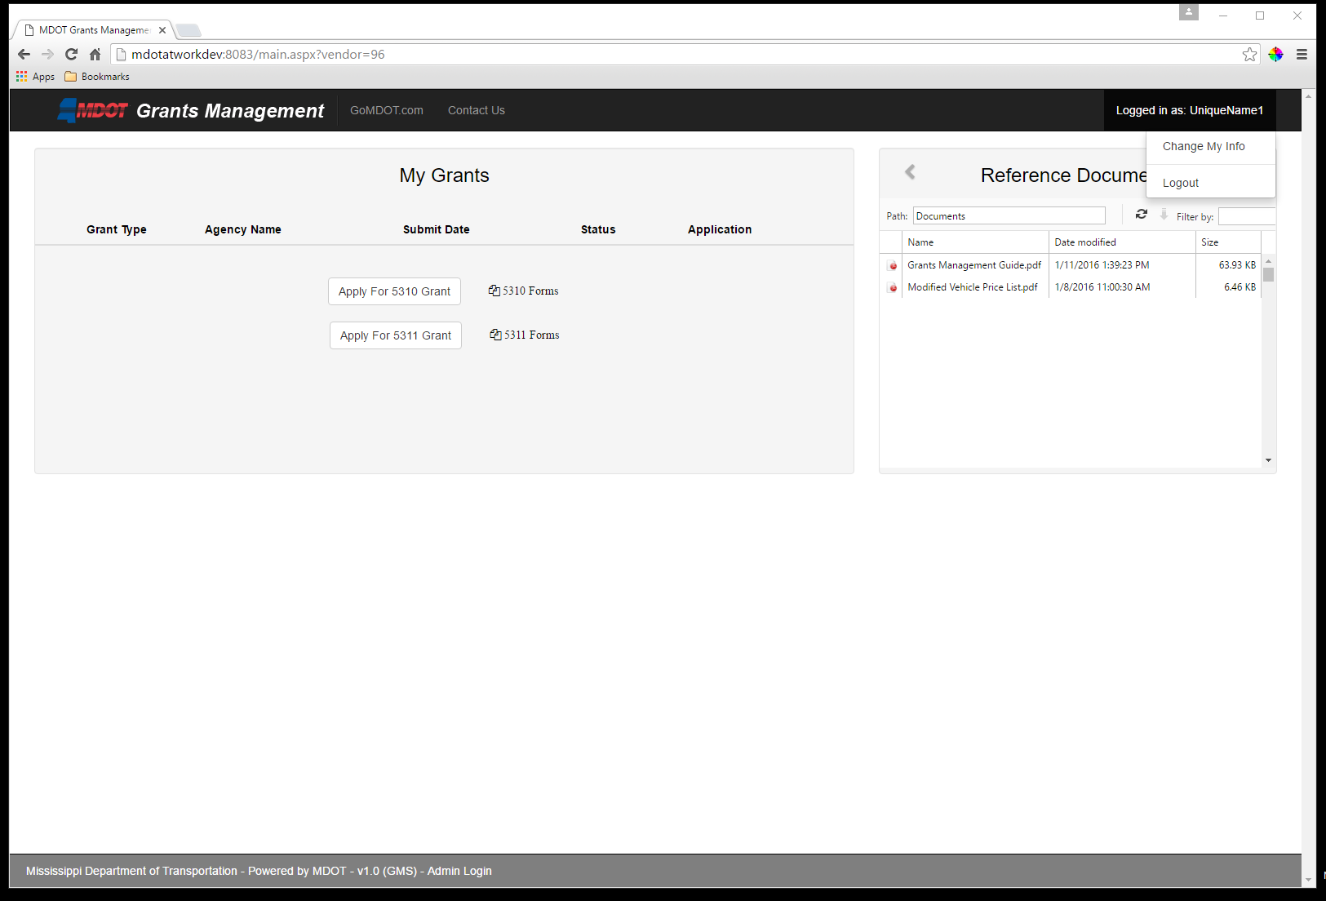
You can view and change the contact information by clicking the Login name in the upper right corner then clicking “Change My Info”

Slide 14
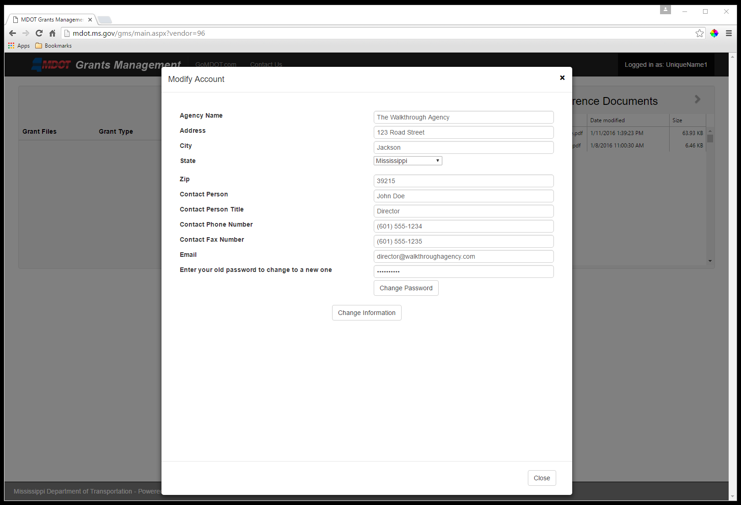
Here an agency can edit all of their contact information
Save changes with the “Change Information” button or go back without saving by clicking the “Close” button

Slide 15
Back on the main page, important reference documents can be downloaded

Slide 16
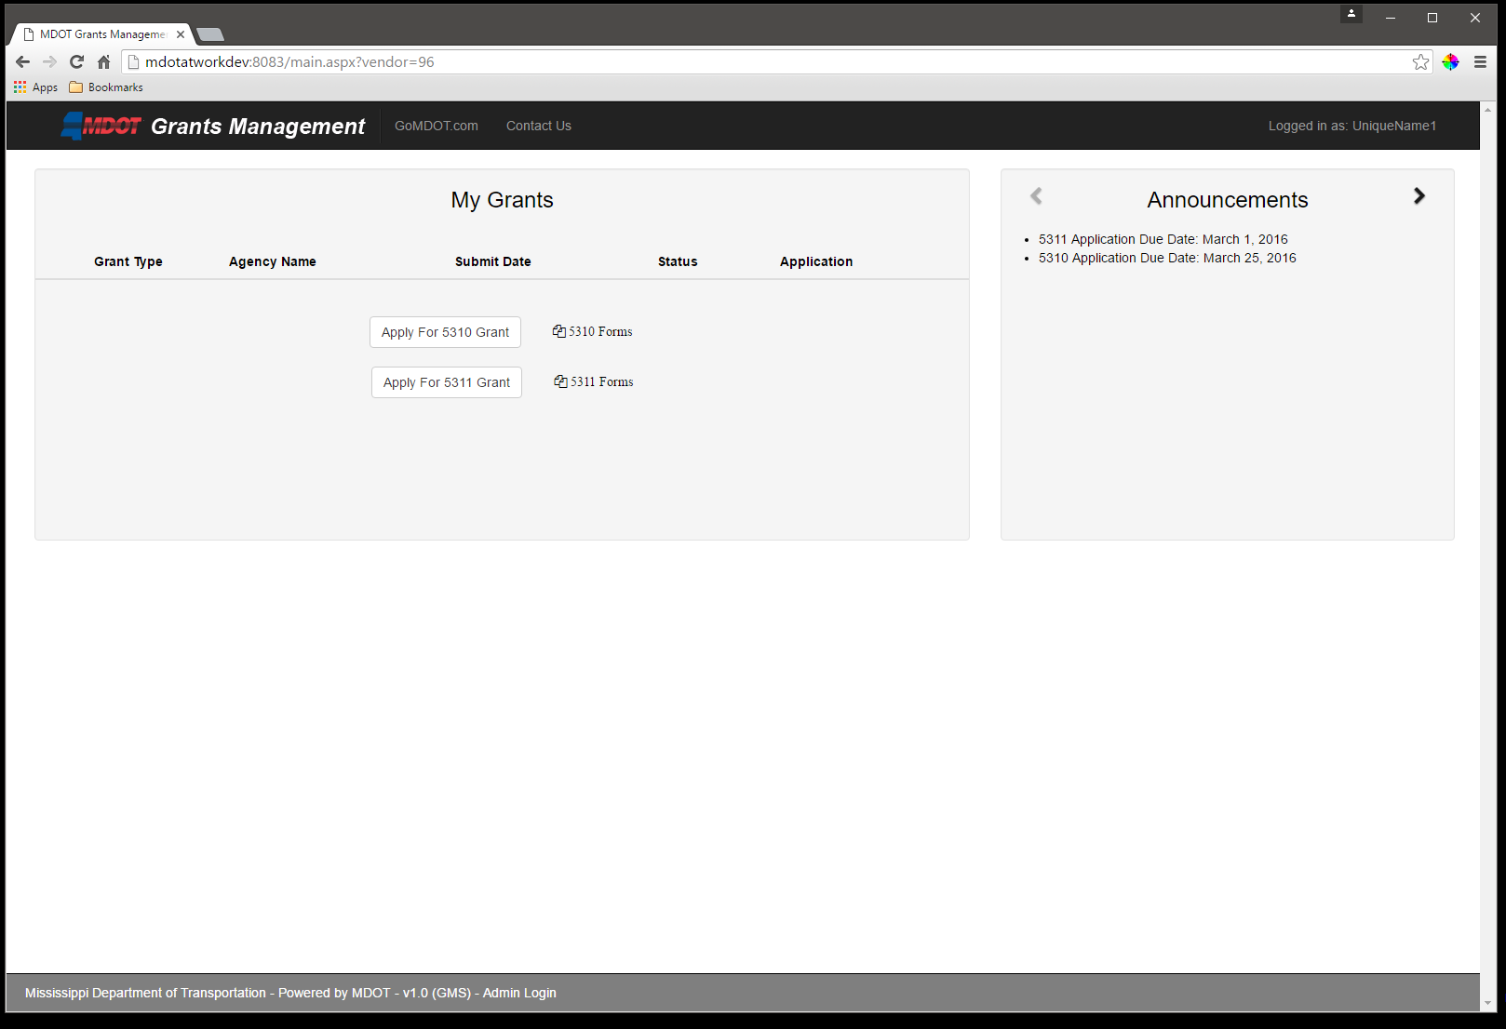
Back on the main page, you can download important reference documents, or click the arrows to view announcements

Slide 17
Step Seven
Choose the grant type for which you wish to apply
Click the “Apply For…” button for the grant for which you will be applying

Slide 18
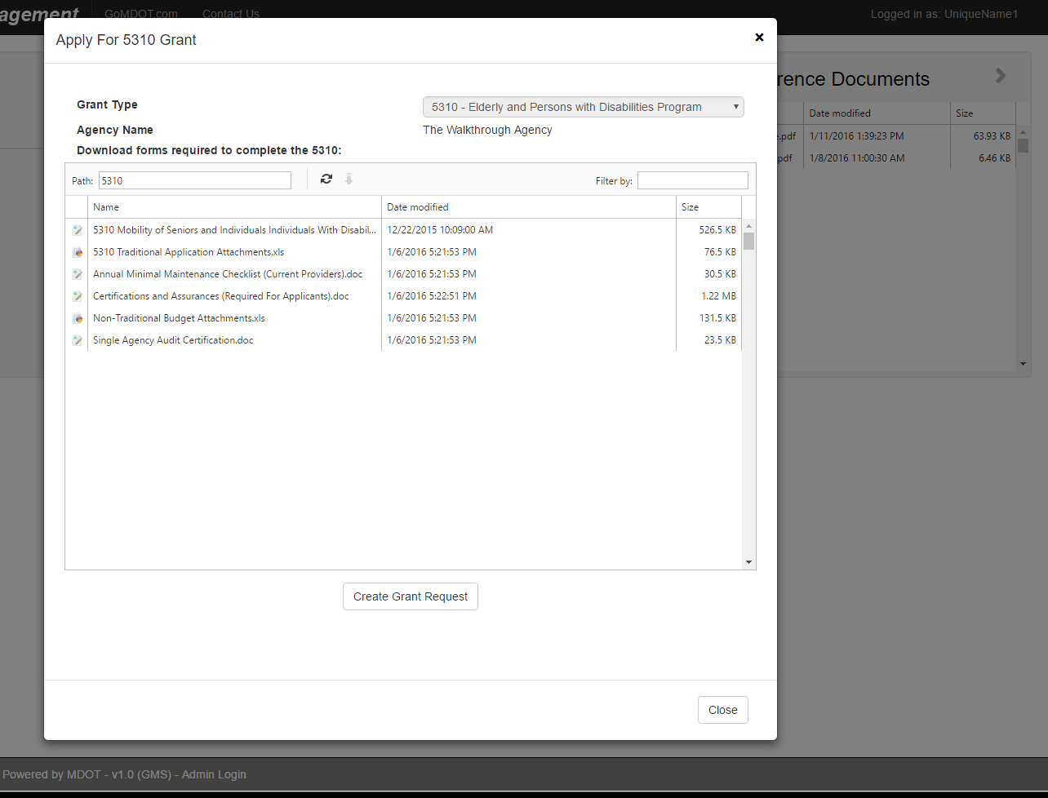
This will pop up a box with all of the forms available for that grant type
Download any of them that you may need then click the “Create Grant Request” button to begin the upload approval process

Slide 19
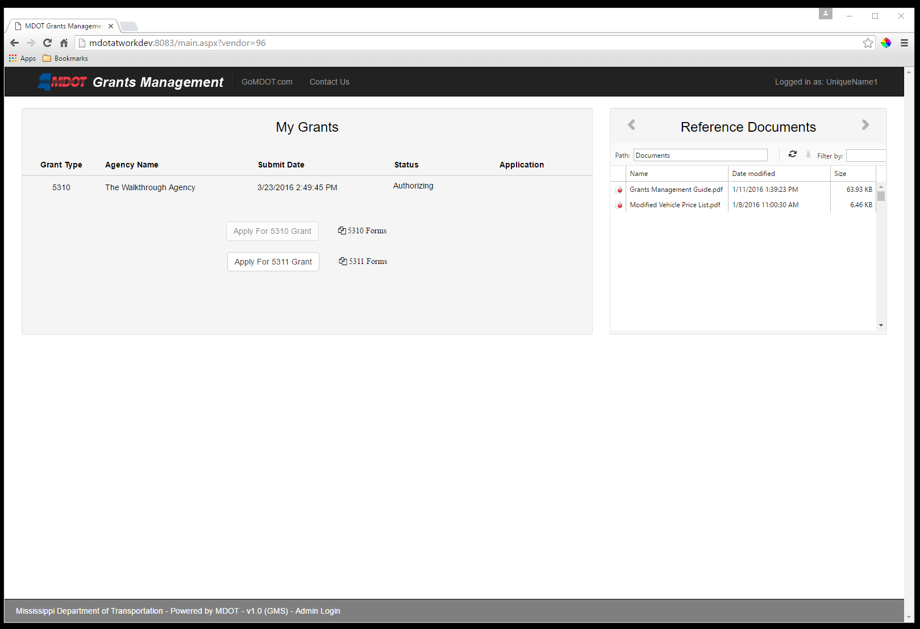
Your main page will show that you have submitted for authorization

Slide 20
Step Eight
Wait
An administrator will email you when they have approved your account for upload. Again, depending on volume, this could be nearly instant, or take some time.

Slide 21
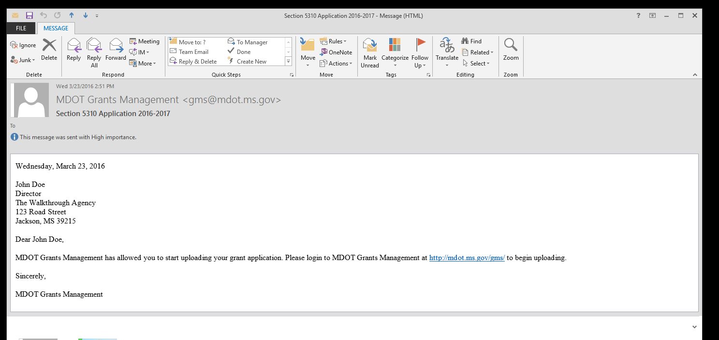
You will receive an email letting you know that your account can upload
It contains a link to return directly to the Grants Management login page
(though it is not necessary to click it or return at this exact moment)

Slide 22
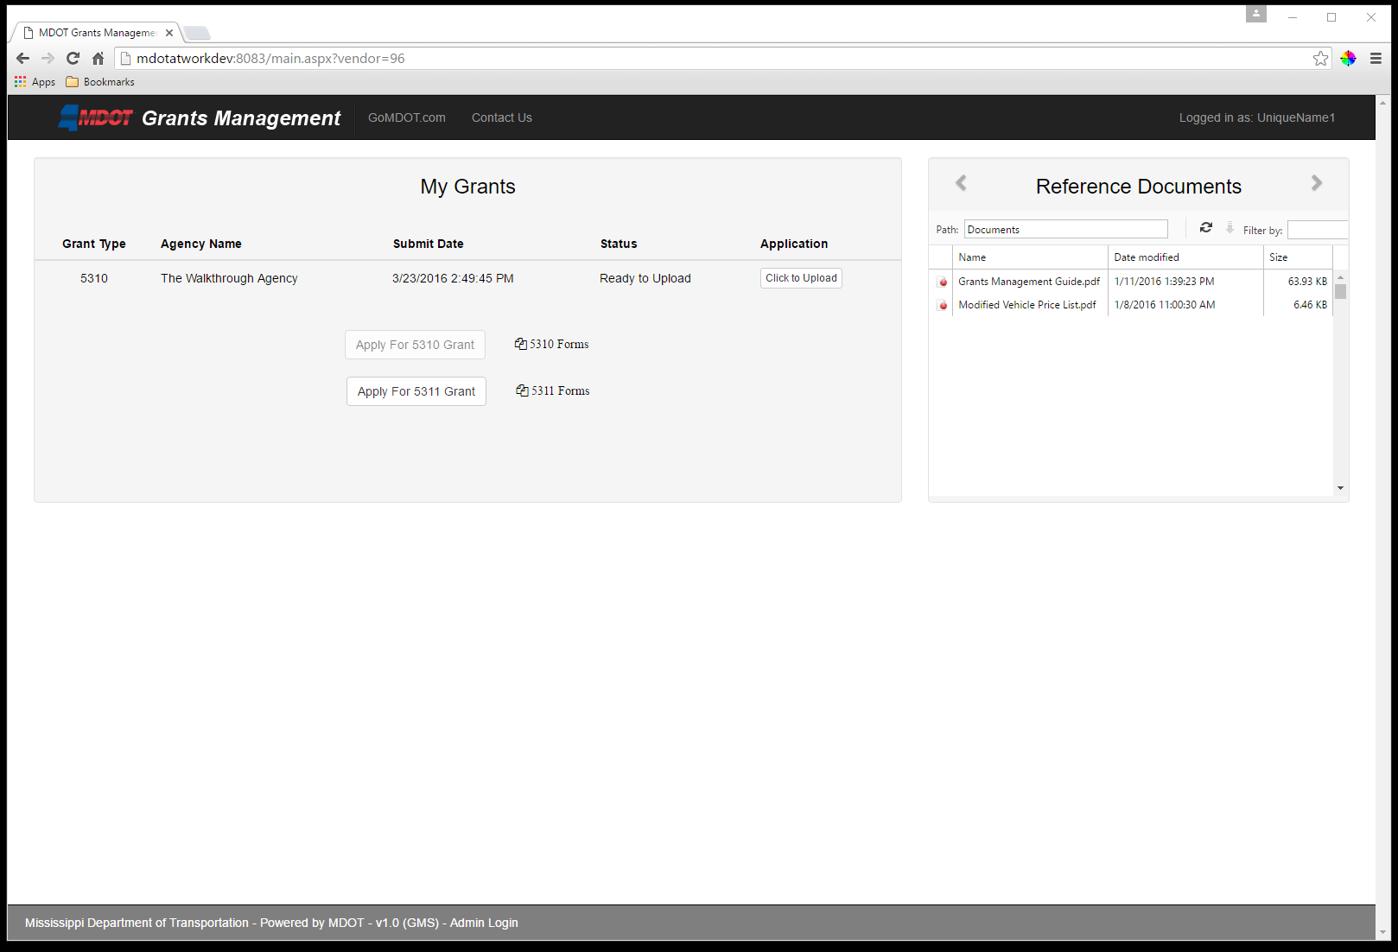
Upon reception of the email, your account is ready to upload.
Log back in (see step 6) and note that your Status has changed to show that it is Ready to Upload

Slide 23
Step Nine
Click the “Click to Upload” button to begin uploading your files

Slide 24
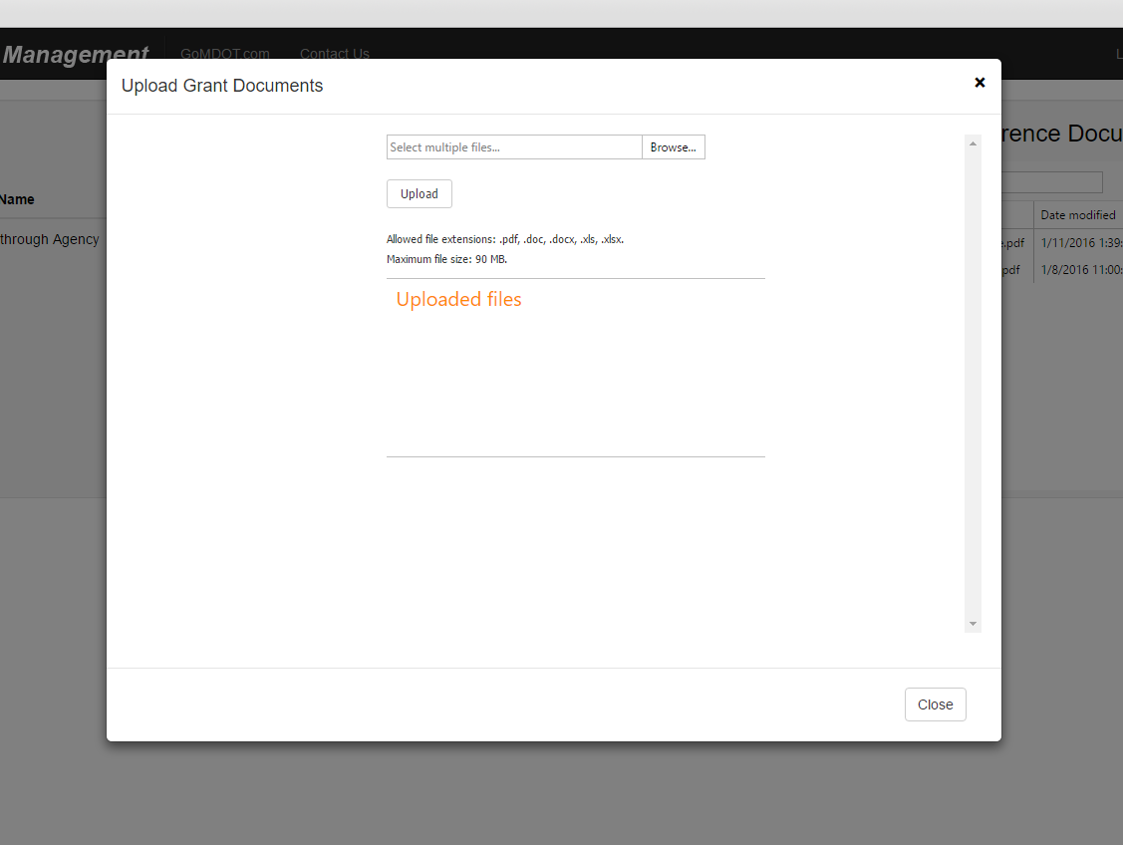
This will pop up a box from which you will upload files

Slide 25
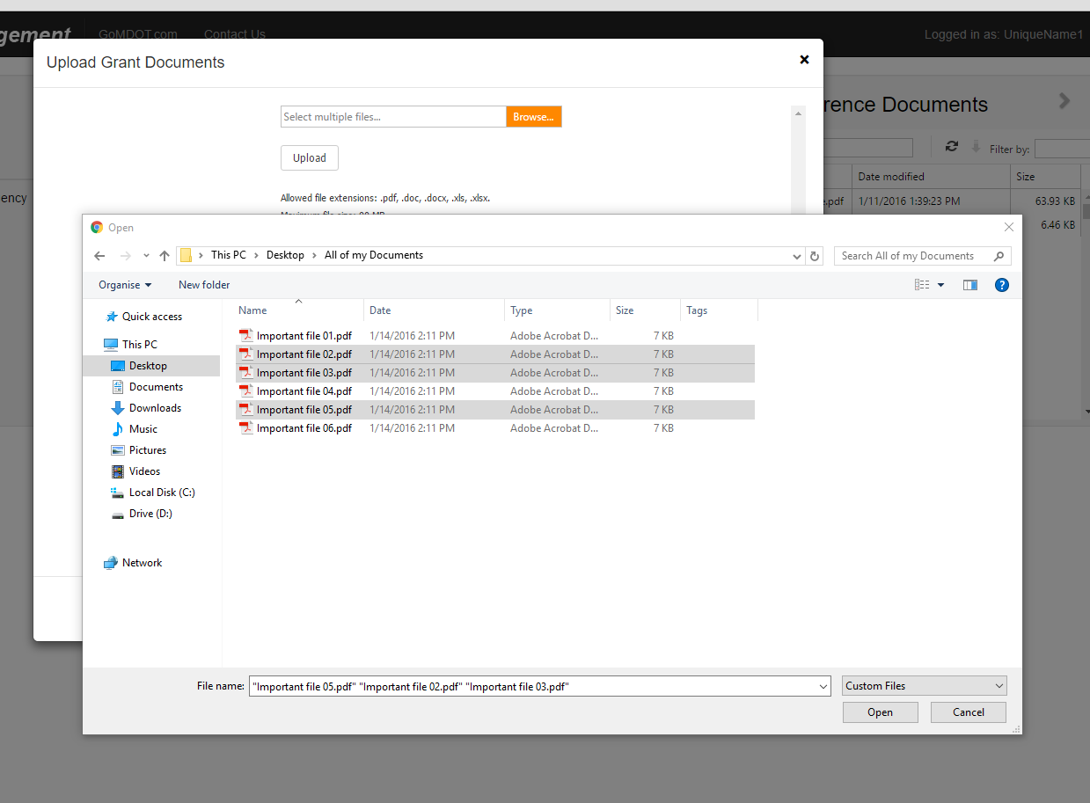
Choose the files on your computer to upload and click the “Open” button

Slide 26
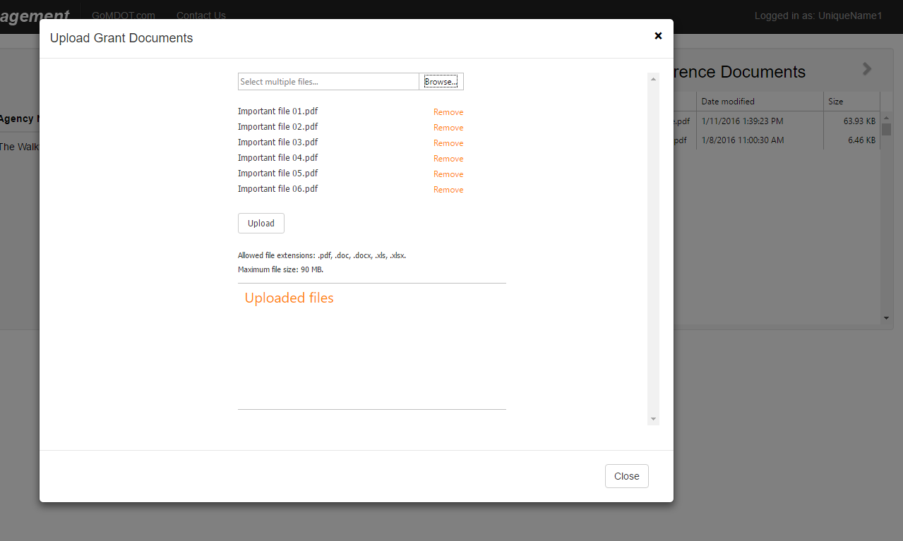
Your chosen files are shown on the upload page
At this point, you can click “Remove” beside any file name to remove it from the list.
You may also click “Browse” to add more files.
When you are satisfied with the files to be uploaded, Click on Upload.

Slide 27
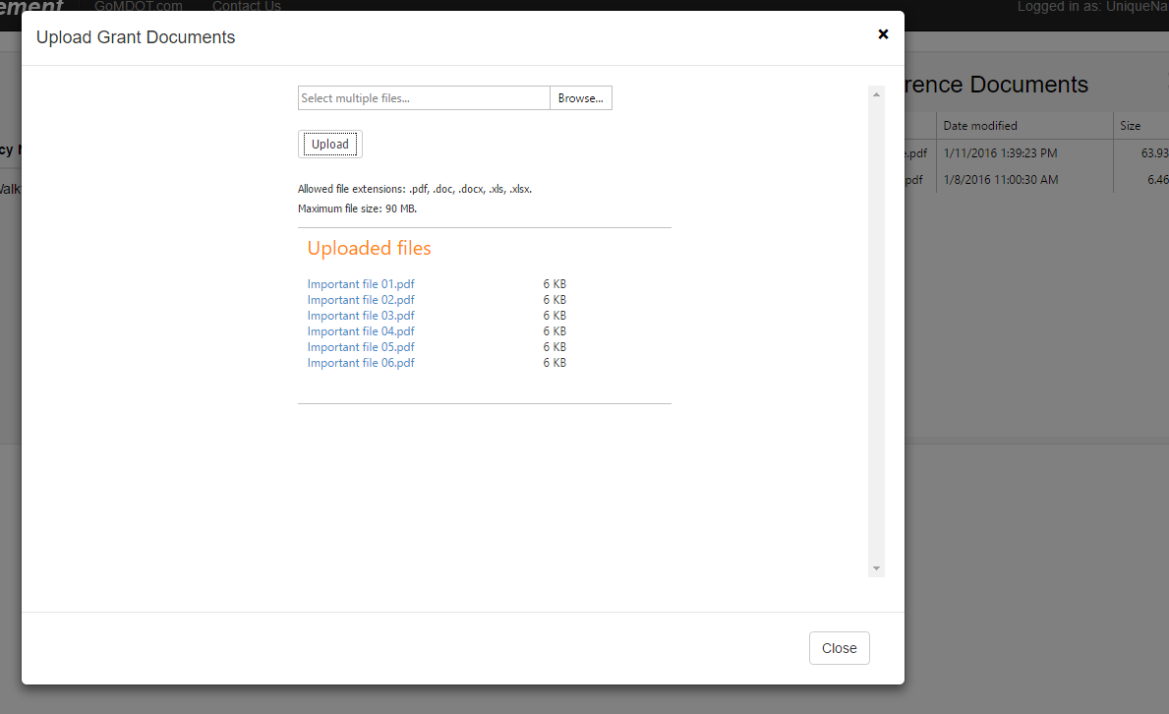
Your files are uploaded to our system. Note the list of files:
At this point, you may “Browse” and “Upload” more files.
The list in blue is only the most recent batch of uploads.

Slide 28
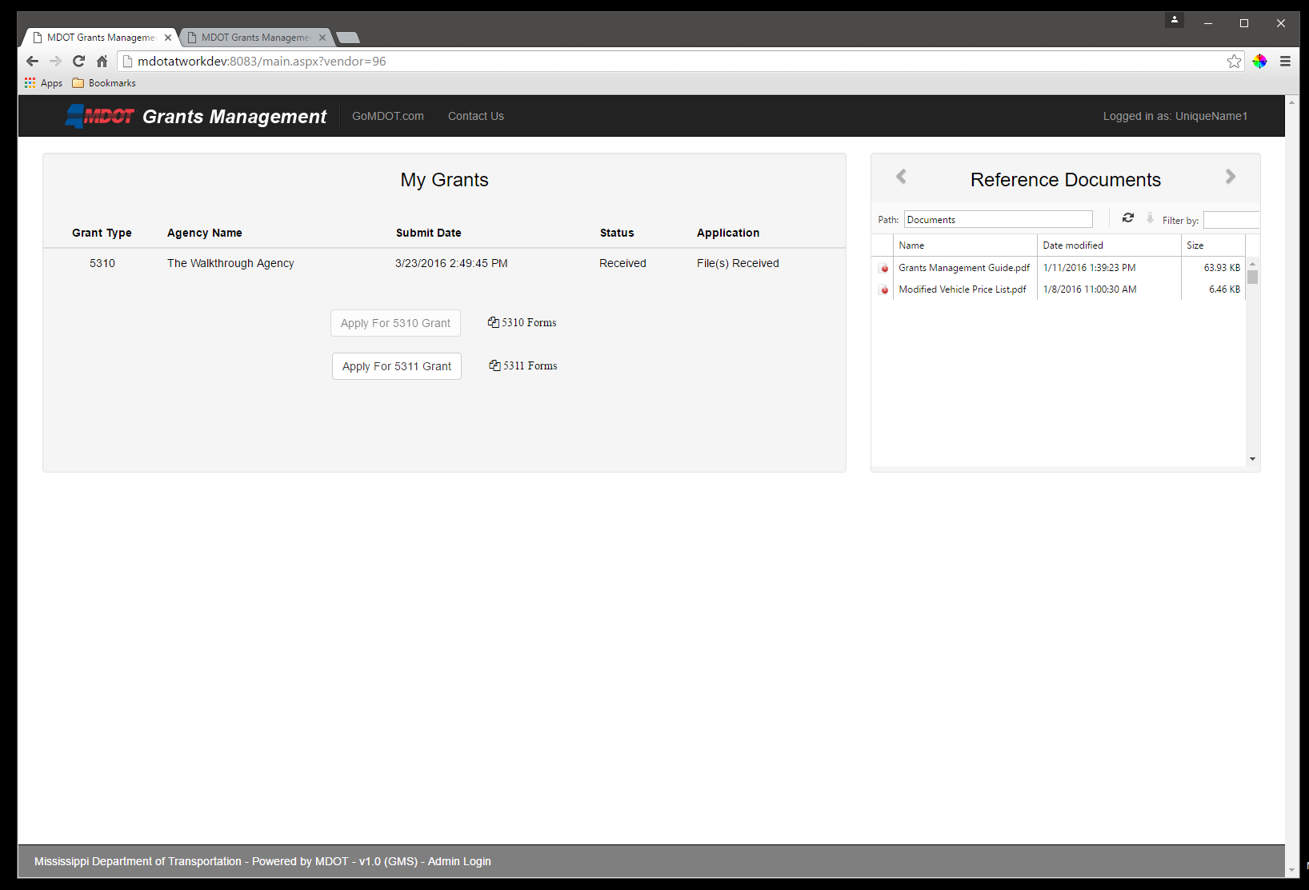
Note that your Status has changed to “Received”
The Application column now shows “File(s) Received” as well

Slide 29
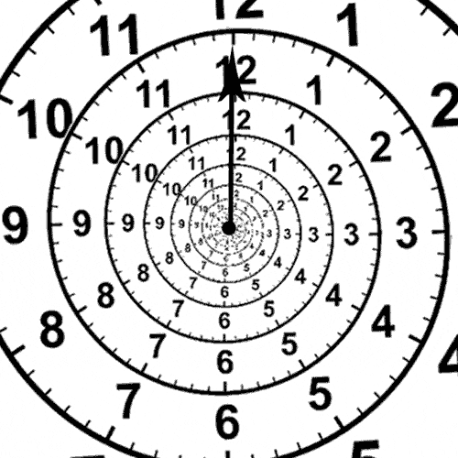
Step Ten
Wait
This will be the longest wait time. Your application will be reviewed in depth. You may be contacted for additional information, or you may only hear from the Grants Management team at the conclusion of the process.

Slide 30
During this time, log back in to check your status.
It will change as the submission moves through the process

Slide 31
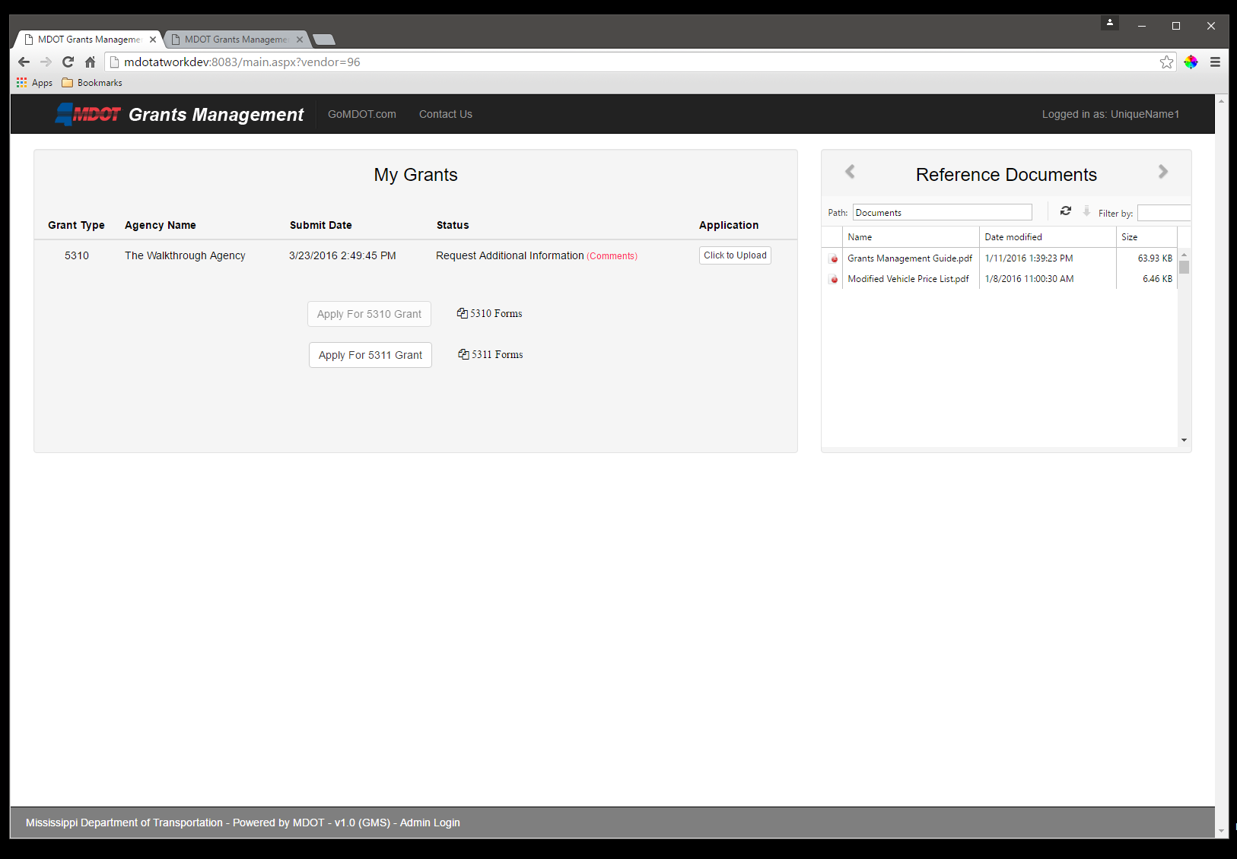
A special case, “Request Additional Information” may appear.

Slide 32
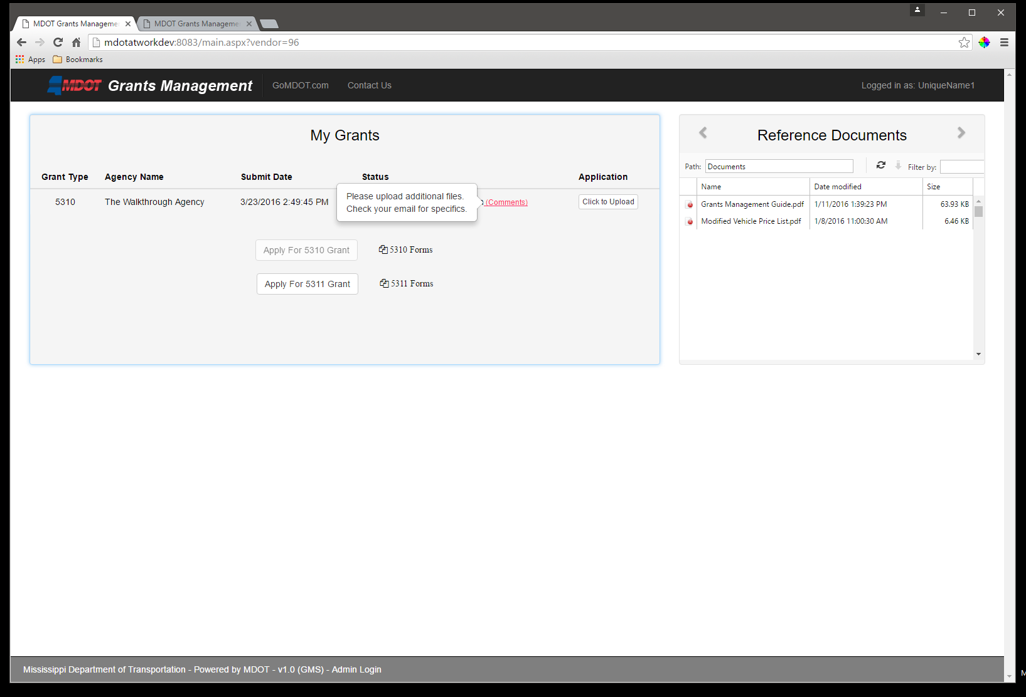
A special case, “Request Additional Information” may appear.
Mouse over the “(Comments)” section to see what information is requested

Slide 33
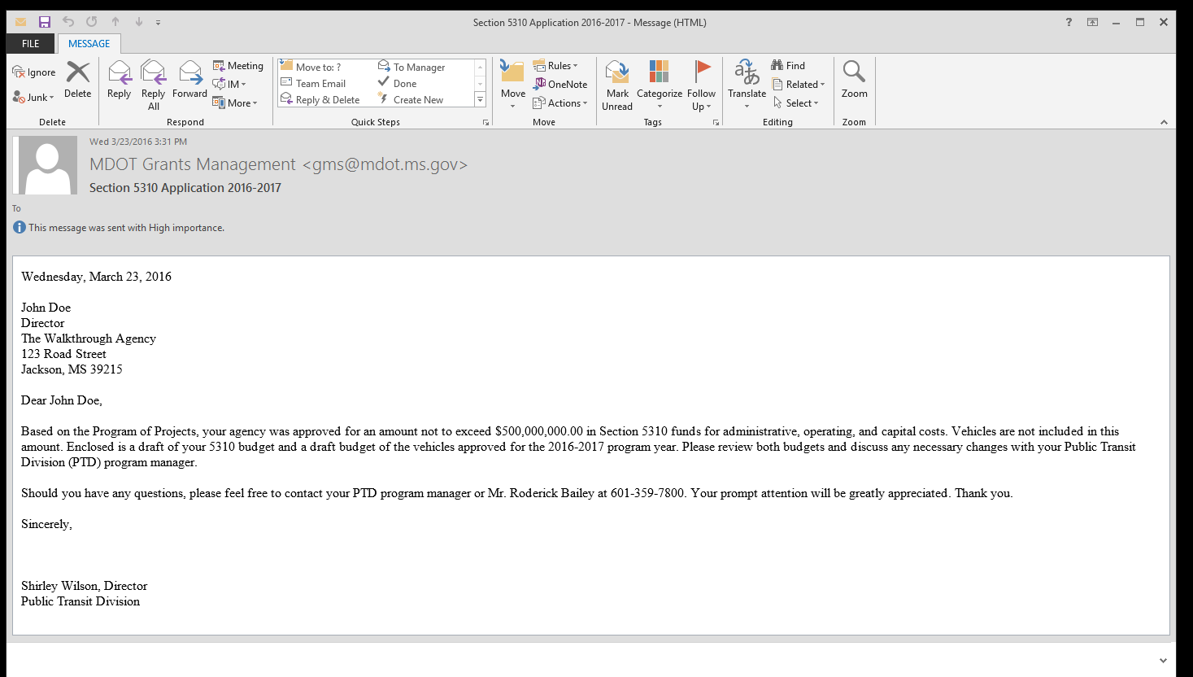
When you are approved or denied you will receive an email letting you know the final status of your grant application

Slide 34
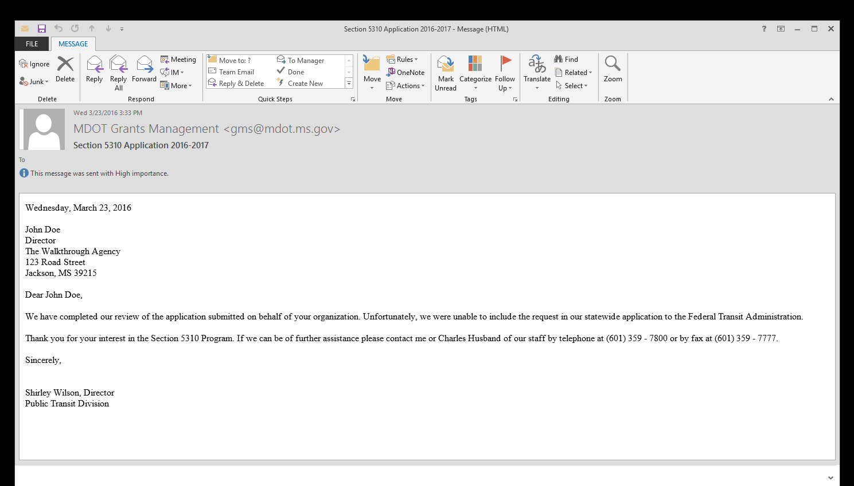
When you are approved or denied you will receive an email letting you know the final status of your grant application

Slide 35
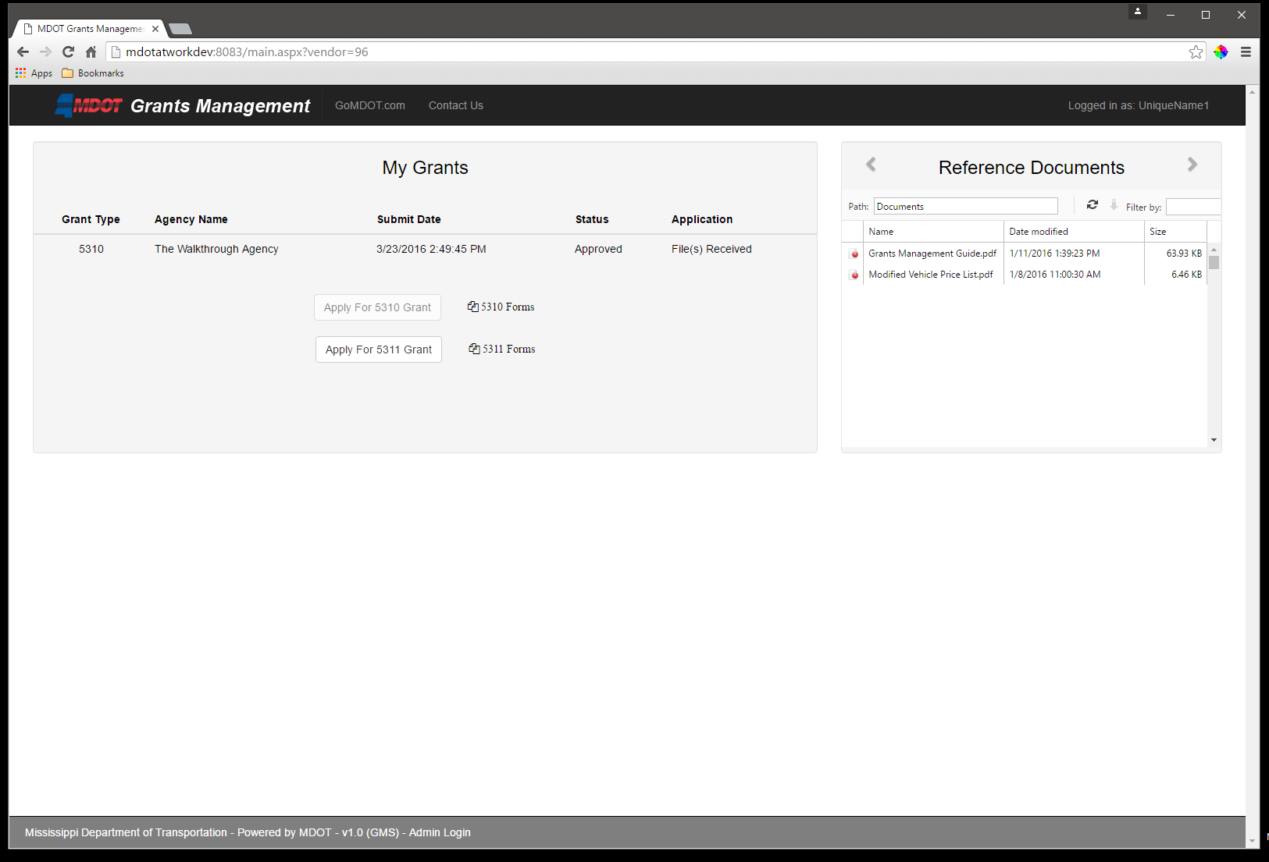
If you log into the Grants Management System after final review, you can see the status of the grant.

Slide 36
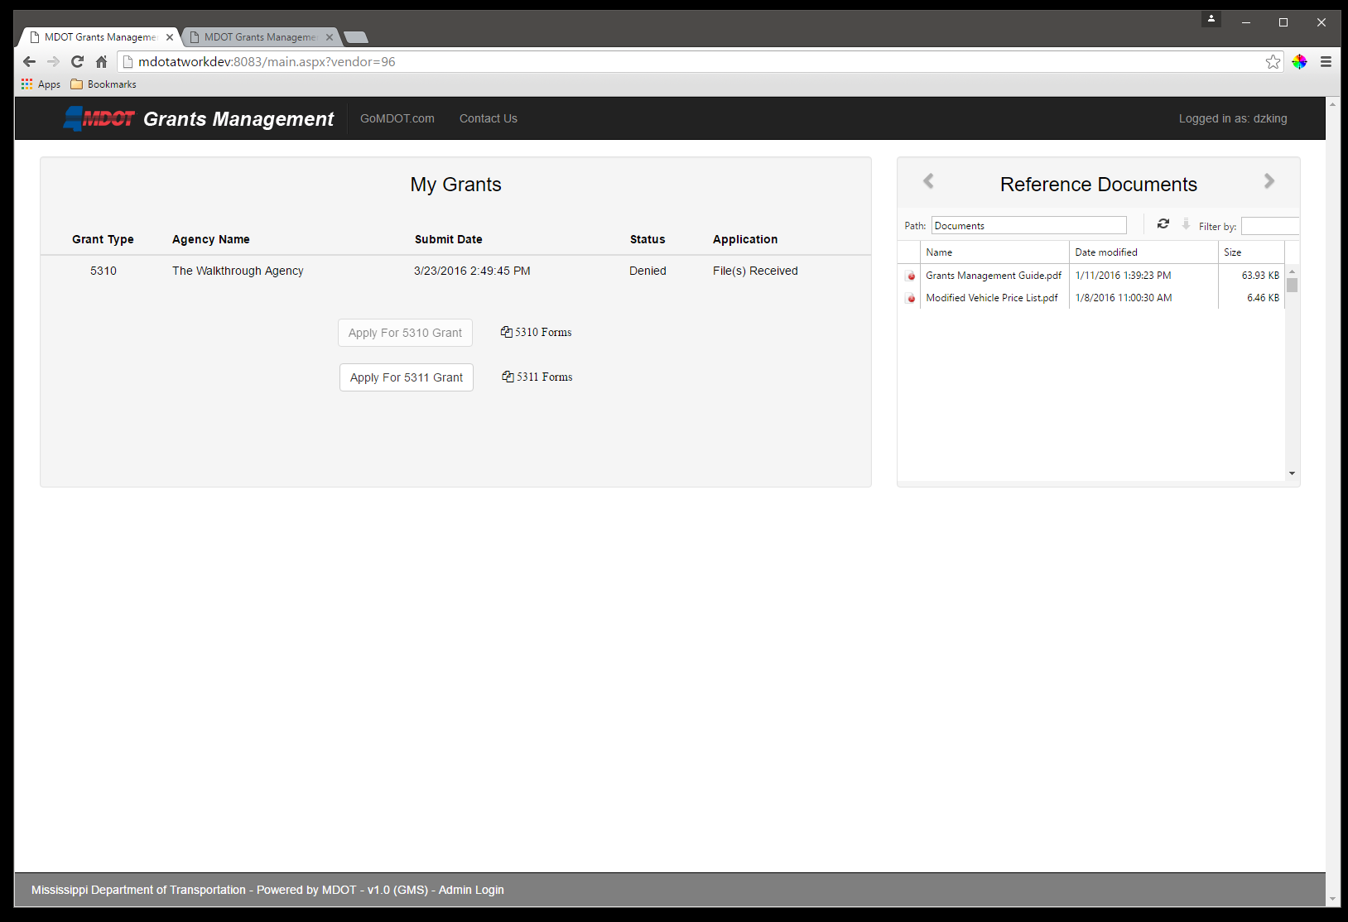
If you log into the Grants Management System after final review, you can see the status of the grant.

Slide 37
Grant Administrator Role and Benefits
The grant administrator functionality will allow us to:
Activate User Accounts
Manage the download and upload of grant application documents for system security purposes
Review the grants from the system and store them in project specific files on the transit server
Send electronic notices to applicant requesting additional information or clarifications

Slide 38
Grant Administrator Role and Benefits (contd.)
Transmit electronic notices of grant status (i.e. received, approved, denied)
Assign applications to team members for review and preparation of grant profiles
Internal management of documents stored in software (don’t have to rely of IT department for application revisions/deletions)
Maintain a list of application requests by program
Benefit of system being created in-house by IT Division
Timely technical assistance/maintenance
Cost-saving – not having to pay an outside vendor
Ability to continue to grow the system without added cost

Slide 39
User Account Screen

Slide 40
Staff Assignment Screen

Slide 41
Grant Disposition Screen

Slide 42
Document Control Screen

Slide 43
What’s Next???
Build in a feature that will allow electronic rating of grant applications by our Interagency Transportation Committee
Ratings are currently done using paper copies
Stop killing trees by eliminating the copying of rating forms
Will allow ITC to rate applications from their offices
System will score the ratings of all committee members
Staff currently entering series of ratings in an excel spreadsheet
Eliminate input errors
System will free up staff time
More timely completion of scoring
Retooling our current sub-recipient reimbursement and fleet operation performance reporting system to make this a function within the grant software.

Slide 44
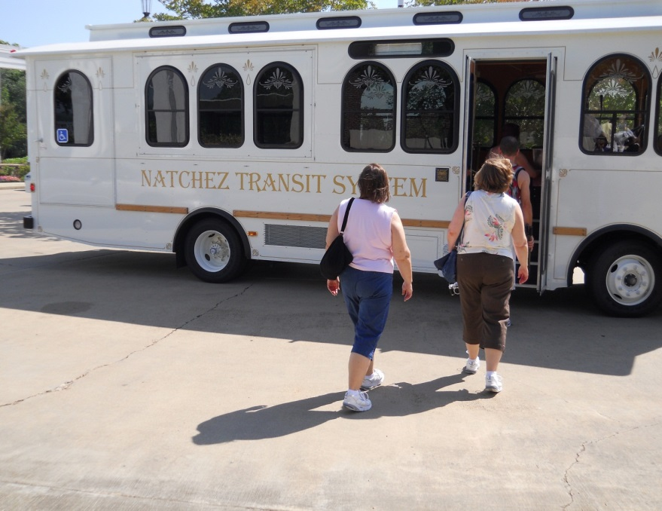
Contact Information
MS Department of Transportation
P.O. Box 1850
Jackson, MS 39215-1850
Public Transit Director: Shirley Wilson
e-mail: swilson@mdot.ms.gov
601-359-7800

